Slide 2
Problems in BDR-1

Slide 3
Review of Block Diagram Simplification Rules
Problems

Slide 4
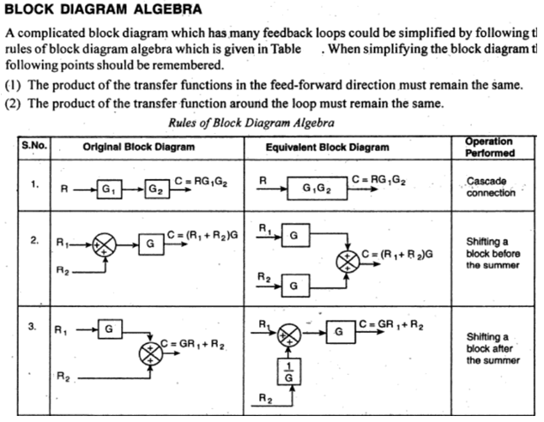
Review of Block Diagram Algebra

Slide 5
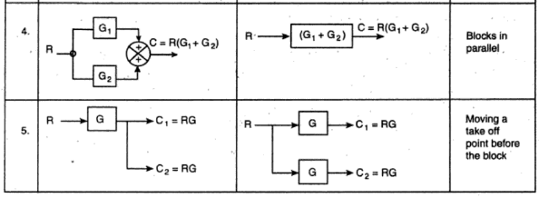
Review of Block Diagram Algebra

Slide 6
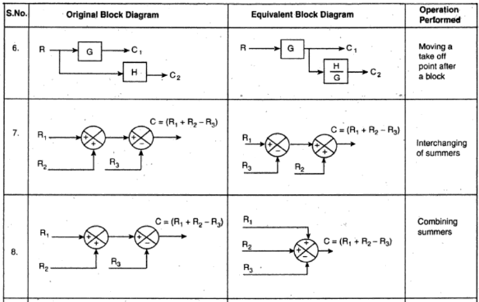
Review of Block Diagram Algebra

Slide 7
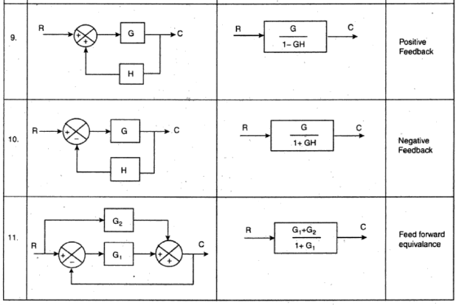
Review of Block Diagram Algebra

Slide 8
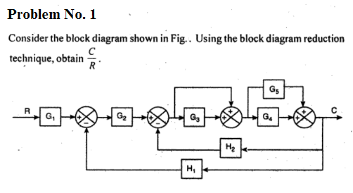
Problems in Block Diagram Reduction

Slide 9
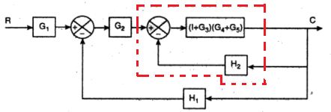
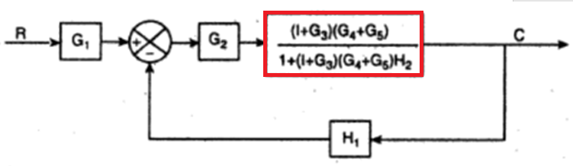
Problems in Block Diagram Reduction

Slide 10
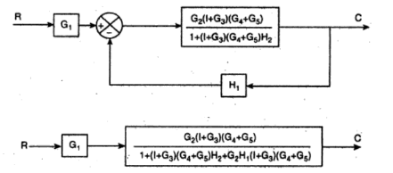

Problems in Block Diagram Reduction

Slide 11

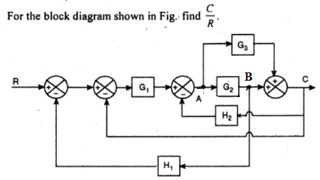
Problems in Block Diagram Reduction

Slide 12
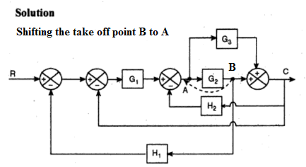
Problems in Block Diagram Reduction

Slide 13
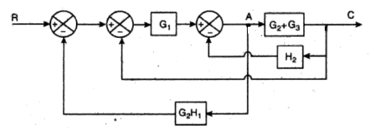
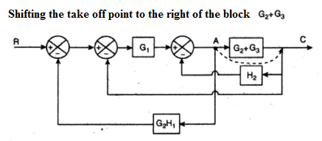
Problems in Block Diagram Reduction

Slide 14
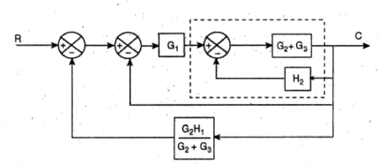
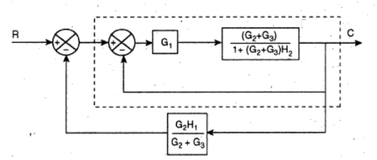
Problems in Block Diagram Reduction

Slide 15
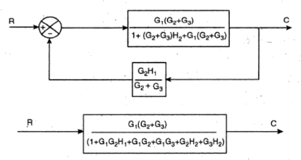

Problems in Block Diagram Reduction

Slide 17
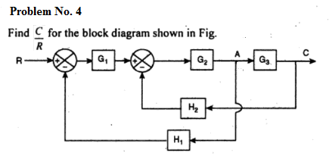
Problems in Block Diagram Reduction

Slide 18
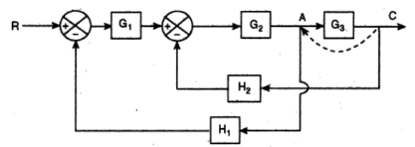
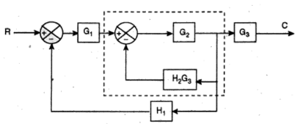
Problems in Block Diagram Reduction

Slide 19
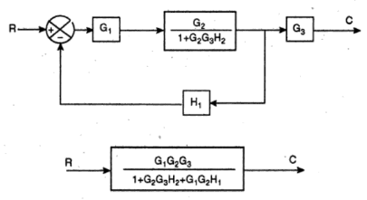

Problems in Block Diagram Reduction

Slide 20
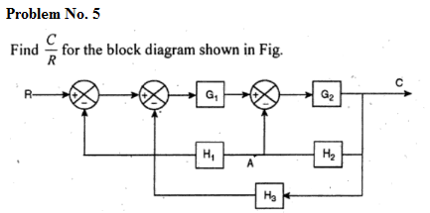
Problems in Block Diagram Reduction

Slide 21
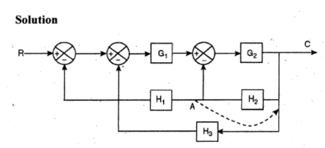
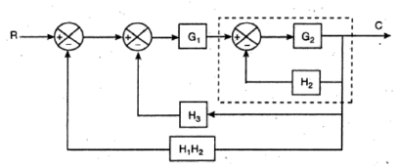
Problems in Block Diagram Reduction

Slide 22
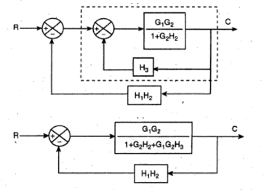
Problems in Block Diagram Reduction

Slide 23
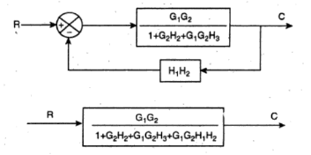

Problems in Block Diagram Reduction

Slide 25
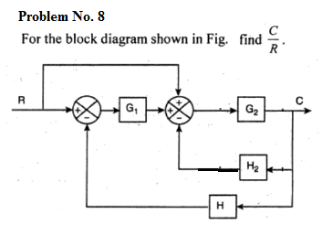
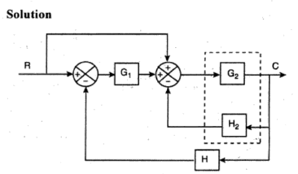
Problems in Block Diagram Reduction

Slide 26
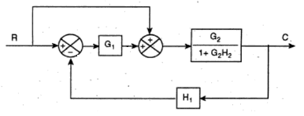
Problems in Block Diagram Reduction

Slide 27
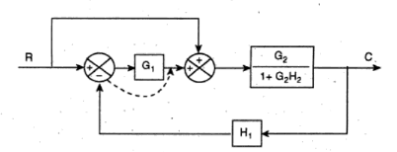
Problems in Block Diagram Reduction

Slide 28
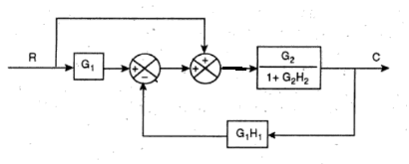
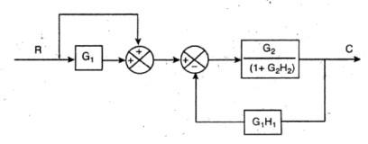
NEXT STEP, SWAPING THE SUMMING BLOCKS ( SWAP WITH THE SIGNS), THE PROBLEM CAN BE SOLVED .. (SHOWN BELOW)

Slide 29
